Slide 1

RULEBERT: Teaching Soft Rules to
Pre-trained Language Models
Mohammad Saeed, Naser Ahmadi, Preslav Nakov, Paolo Papotti. 2021, EMNLP
2022.01.14
Seokho Ahn
sokho0514@gmail.com

Slide 2

Contents
Introduction
Requirements
Dataset
Teaching PLMs to Reason
Experiments
RULEBERT on External Datasets
Conclusion

Slide 3
Introduction
Backgrounds
Pre-trained language models(PLMs) are established tools for capturing both linguistic and factual knowledge
Even the largest models fail on basic reasoning tasks
Most of the rules are soft, thus have a certain confidence of being correct
Eg) Across the 7,015 logical rules defined on the Dbpia knowledge graph, only 11% have a confidence above 95%

Slide 4
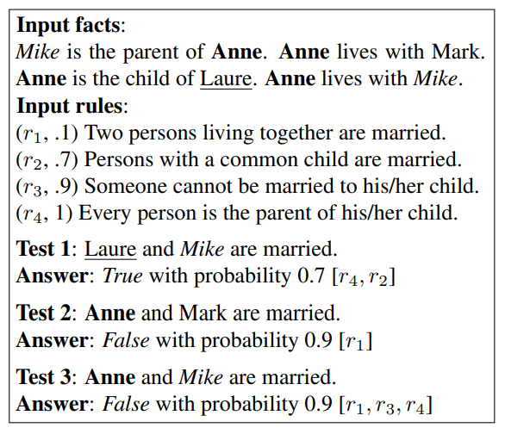
Introduction
Proposal
Teaching PLMs how to reason with soft Horn rules
Enable deductive reasoning for a large class of soft rules with binary predicates
Makes use of synthetic examples that “teach” the desired formal behavior through fine-tuning
Mike
Laure
live
parent
child
Anne
Mark
live

Slide 5
Introduction
Contributions
Introduce the problem of teaching soft rules expressed in a synthetic language to PLMs through fine-tuning
Create the dataset which contains 3.2M examples derived from 161 rules describing real common-sense patterns with the target probability
Introduce techniques to predict the correct probability of the reasoning output for the given soft rules and facts
Introducing RULEBERT, can effectively reason with facts and rules that it has not seen at training, even when fine-tuned with only 20 rules
Demonstrate that fine-tuning approach effectively transfer knowledge about predicate negation and symmetry to the lower levels of the transformer

Slide 6
Introduction
Related Work
PLMs(Pre-trained Language Models)
QA(Question Answering)
Semantically parse natural language
NLI(Natural Language Inference)
Textual entailment
Ad-hoc module for neural reasoning

Slide 7
Requirements
Language models
Focus on language models pre-trained with bidirectional transformer
Logical rules
Existing corpora of declarative Horn rules mined from large RDF knowledge bases(KBs)
Rule confidence
Rules are annotated with a measure of likelihood or computed confidence
Probabilistic answer set programming(ASP)
Adopt LPMLN to create the dataset

Slide 8

Requirements
Logical rules
$p(s, o)$: Facts
$h(x, y)$: Single atom
$B→h(x, y)$: Horn clause
Examples:
$$birthYear\left(b, d\right) ∧ foundYear\left(a, c\right)∧ <\left(c, d\right) → negfounder\left(a, b\right)$$
* b: any person, d: birth year, c: founding year, a: any company

Slide 9
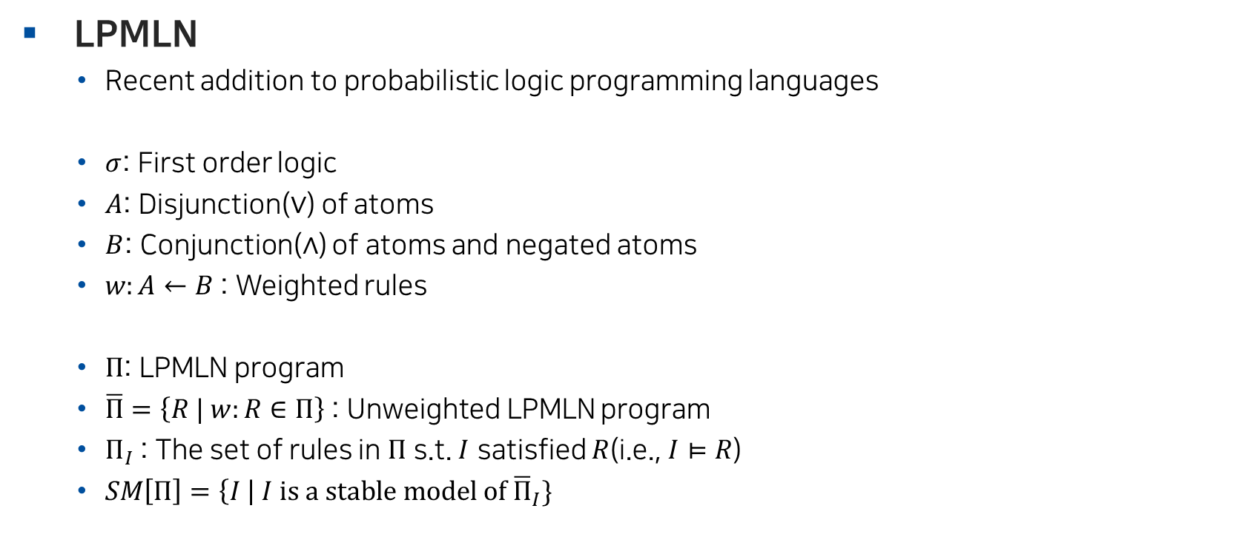
Requirements
LPMLN
Recent addition to probabilistic logic programming languages
$σ$: First order logic
$A$: Disjunction($∨$) of atoms
$B$: Conjunction($∧$) of atoms and negated atoms
$w:A←B$: Weighted rules
$Π$: LPMLN program
$\overline{Π}=\left\{R | w:R∈Π\right\}$: Unweighted LPMLN program
$Π_{I}$: The set of rules in $Π$ s.t. $I$ satisfied $R$(i.e., $I⊨R$)
$SM\left[Π\right]=\left\{I \right| I is a stable model of {\overline{Π}}_{I}\}$

Slide 10



Requirements
LPMLN
Weight of $I$ under $∏$:
Probability of $I$ under $∏$:
$$W_{Π}\left(I\right)=\left\{\begin{aligned}\exp\left(\sum_{w:R∈Π_{I}}{w}\right) if I∈SM[Π] \\ 0 otherwise \end{aligned}\right.$$
$$P_{Π}\left(I\right)=\lim_{α→∞}{\frac{W_{Π}\left(I\right)}{\sum_{J∈SM[Π]}{W_{Π}\left(J\right)}}}$$

Slide 11
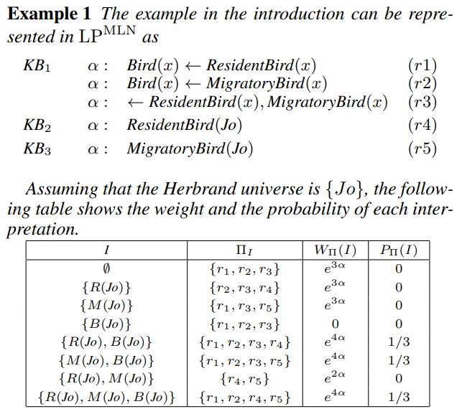
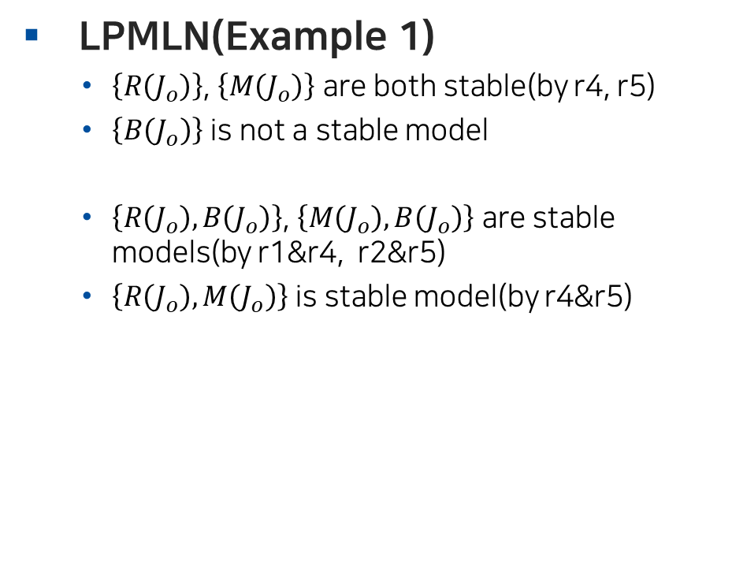
Requirements
LPMLN(Example 1)
$\left\{R\left(J_{o}\right)\right\}$, $\left\{M\left(J_{o}\right)\right\}$ are both stable(by r4, r5)
$\left\{B\left(J_{o}\right)\right\}$ is not a stable model
$\left\{R\left(J_{o}\right),B\left(J_{o}\right)\right\}$, $\left\{M\left(J_{o}\right),B\left(J_{o}\right)\right\}$ are stable models(by r1&r4, r2&r5)
$\left\{R\left(J_{o}\right),M\left(J_{o}\right)\right\}$ is stable model(by r4&r5)
Joohyung Lee and Yi Wang. 2016. Weighted rules under the stable model semantics. KR ’16, page 145–154, Cape Town, South Africa.

Slide 12

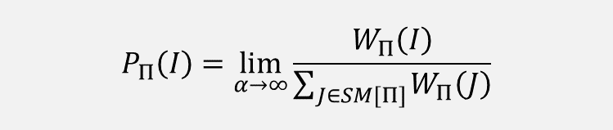
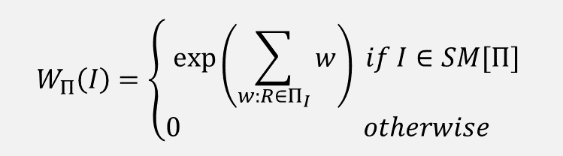
Requirements
LPMLN(Example 1)
Weight of $I$ under $∏$:
Probability of $I$ under $∏$:
$$W_{Π}\left(I\right)=\left\{\begin{aligned}\exp\left(\sum_{w:R∈Π_{I}}{w}\right) if I∈SM[Π] \\ 0 otherwise \end{aligned}\right.$$
$$P_{Π}\left(I\right)=\lim_{α→∞}{\frac{W_{Π}\left(I\right)}{\sum_{J∈SM[Π]}{W_{Π}\left(J\right)}}}$$
Joohyung Lee and Yi Wang. 2016. Weighted rules under the stable model semantics. KR ’16, page 145–154, Cape Town, South Africa.

Slide 13
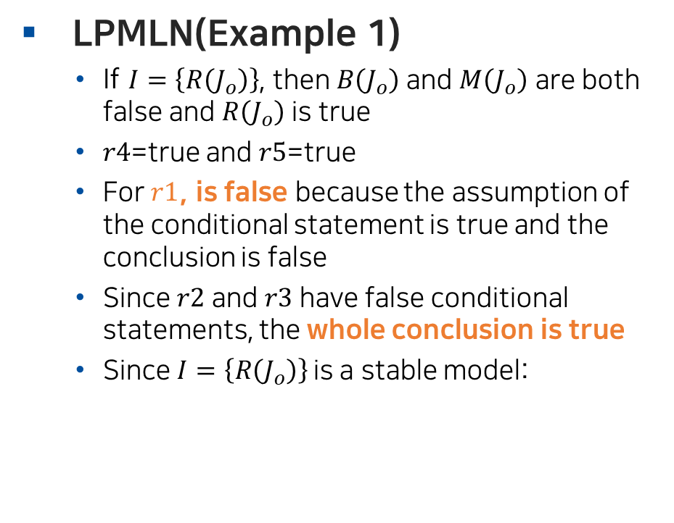
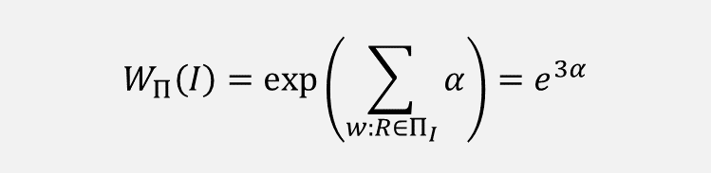
Requirements
LPMLN(Example 1)
If $I=\left\{R\left(J_{o}\right)\right\}$, then $B\left(J_{o}\right)$ and $M\left(J_{o}\right)$ are both false and $R\left(J_{o}\right)$ is true
$r4$=true and $r5$=true
For $r1$, is false because the assumption of the conditional statement is true and the conclusion is false
Since $r2$ and $r3$ have false conditional statements, the whole conclusion is true
Since $I=\left\{R\left(J_{o}\right)\right\}$is a stable model:
$$W_{Π}\left(I\right)=\exp\left(\sum_{w:R∈Π_{I}}{α}\right)=e^{3α}$$
Joohyung Lee and Yi Wang. 2016. Weighted rules under the stable model semantics. KR ’16, page 145–154, Cape Town, South Africa.

Slide 14
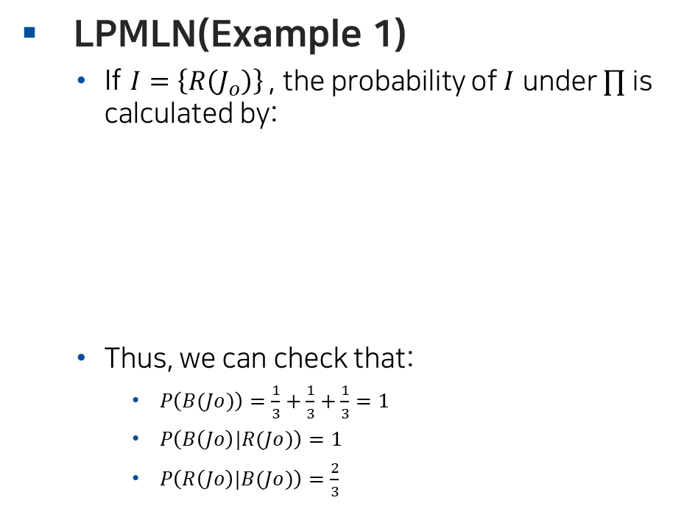
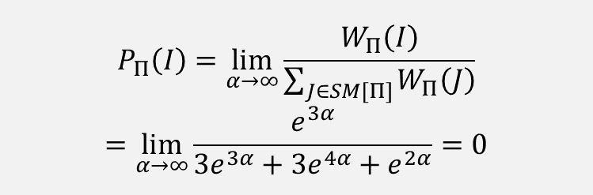
Requirements
LPMLN(Example 1)
If $I=\left\{R\left(J_{o}\right)\right\}$, the probability of $I$ under $∏$ is calculated by:
Thus, we can check that:
$P\left(B(Jo)\right)=\frac{1}{3}+\frac{1}{3}+\frac{1}{3}=1$
$P\left(B\left(Jo\right)|R(Jo)\right)=1$
$P\left(R\left(Jo\right)|B(Jo)\right)=\frac{2}{3}$
$$P_{Π}\left(I\right)=\lim_{α→∞}{\frac{W_{Π}\left(I\right)}{\sum_{J∈SM[Π]}{W_{Π}\left(J\right)}}}$$
$$=\lim_{α→∞}{\frac{e^{3α}}{{3e}^{3α}+{3e}^{4α}+e^{2α}}=0}$$
Joohyung Lee and Yi Wang. 2016. Weighted rules under the stable model semantics. KR ’16, page 145–154, Cape Town, South Africa.

Slide 15
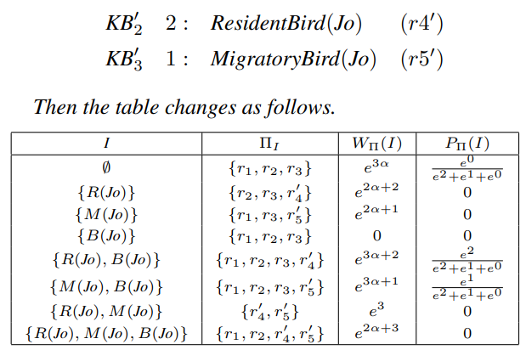
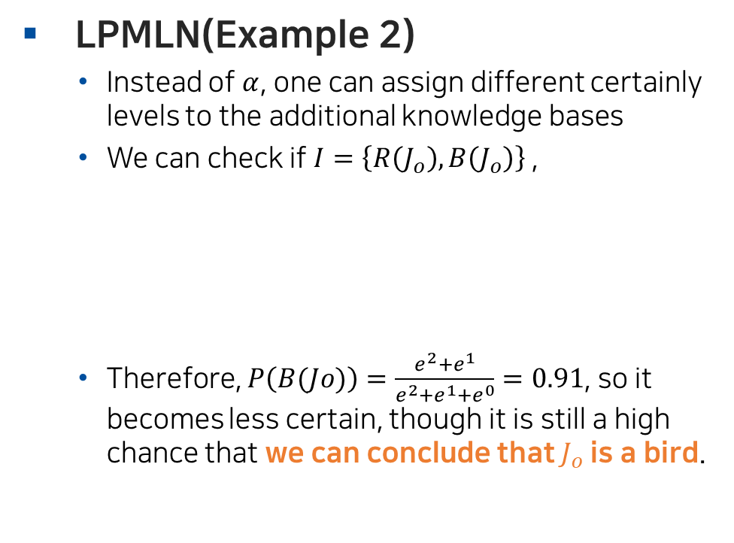
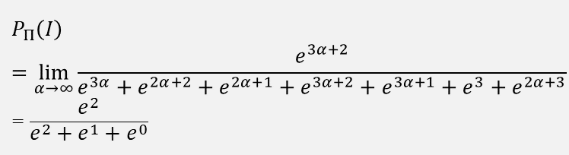
Requirements
LPMLN(Example 2)
Instead of $α$, one can assign different certainly levels to the additional knowledge bases
We can check if $I=\left\{R\left(J_{o}\right),B\left(J_{o}\right)\right\}$,
Therefore, $P\left(B(Jo)\right)=\frac{e^{2}+e^{1}}{e^{2}+e^{1}+e^{0}}=0.91$, so it becomes less certain, though it is still a high chance that we can conclude that $J_{o}$ is a bird.
$$P_{Π}\left(I\right)=\lim_{α→∞}{\frac{e^{3α+2}}{e^{3α}+e^{2α+2}+e^{2α+1}+e^{3α+2}+e^{3α+1}+e^{3}+e^{2α+3}}}$$
$$=\frac{e^{2}}{e^{2}+e^{1}+e^{0}}$$
Joohyung Lee and Yi Wang. 2016. Weighted rules under the stable model semantics. KR ’16, page 145–154, Cape Town, South Africa.

Slide 16
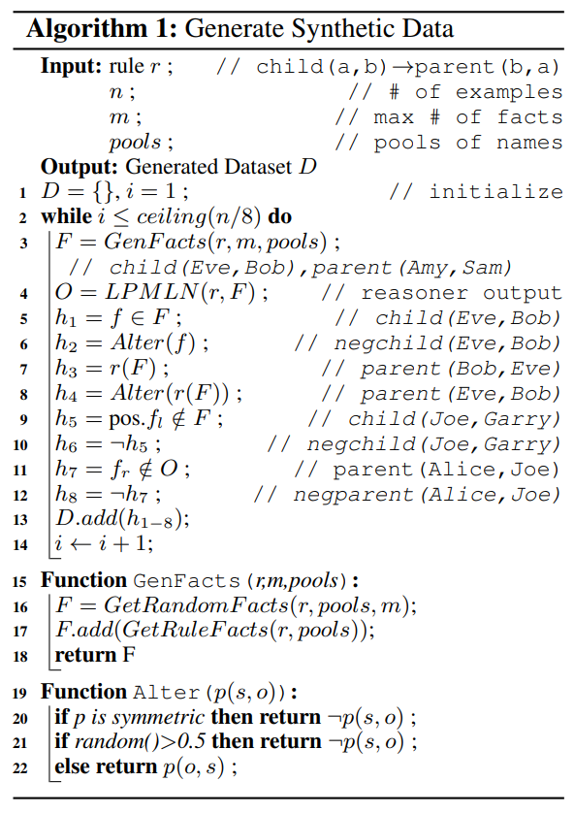
Dataset
Single-Rule dataset generation
This process is not about teaching the model specific facts, but teaching it reasoning patterns
Introduces additional complexity as examples must show how to deal with the symmetry of the predicate
Based on CWA(Closed world assumption), assume that positive triples are false if they cannot be proven
For single-rule scenario, release a dataset for 161 rules with a total of 3.2M examples

Slide 17
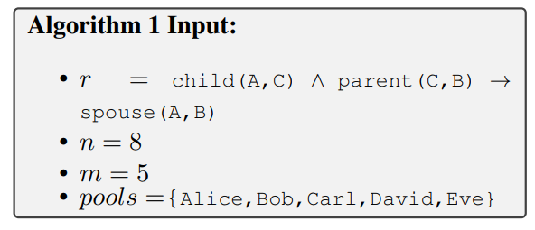
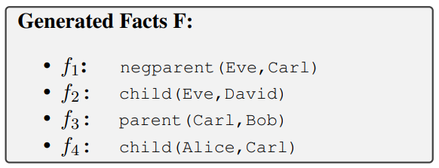
Dataset
Single-Rule dataset generation

Slide 18
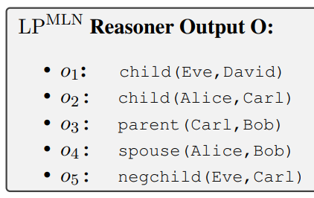
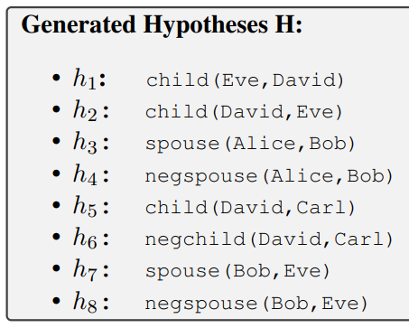
Dataset
Single-Rule dataset generation

Slide 19
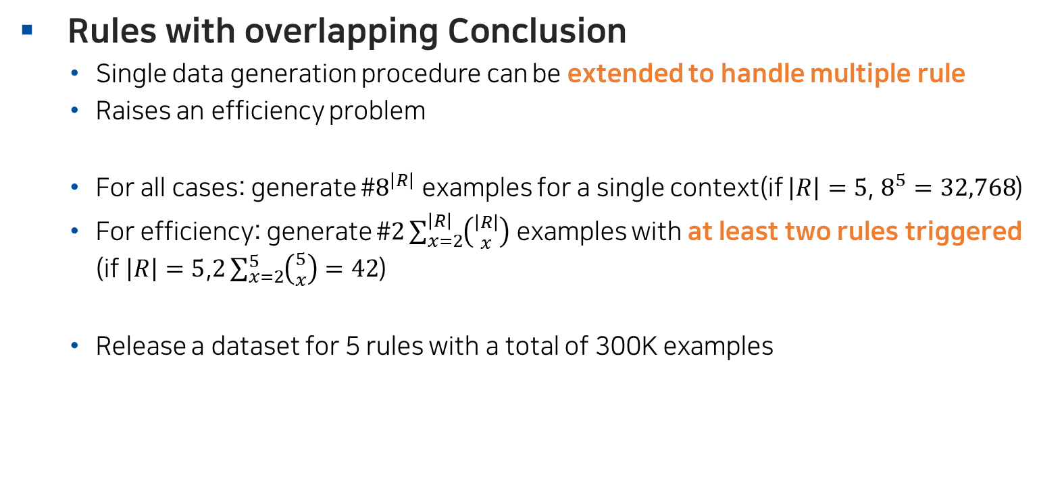
Dataset
Rules with overlapping Conclusion
Single data generation procedure can be extended to handle multiple rule
Raises an efficiency problem
For all cases: generate #$8^{\left|R\right|}$ examples for a single context(if $\left|R\right|=5$, $8^{5}=32,768$)
For efficiency: generate #$2\sum_{x=2}^{\left|R\right|}{\left({\left|R\right| \atop x}\right)}$ examples with at least two rules triggered (if $\left|R\right|=5$,$2\sum_{x=2}^{5}{\left({5 \atop x}\right)}=42$)
Release a dataset for 5 rules with a total of 300K examples

Slide 20
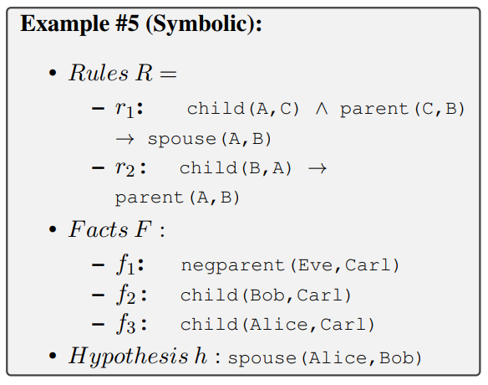

Dataset
Chaining of Rule Executions
An answer may be obtained by executing rules in a sequence
Generate a rule-conclusion hypothesis and its alteration for each depth
The dataset for $d≤5$ contains a total of 700K examples
(Depth=2)

Slide 21
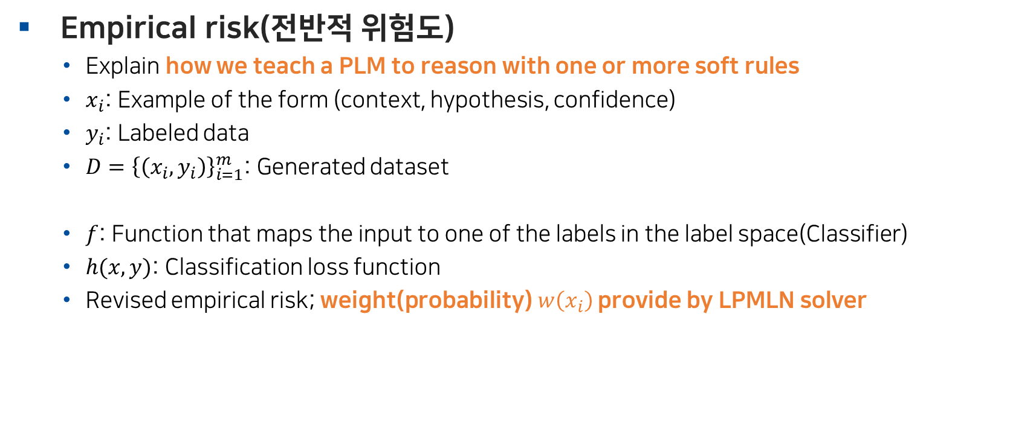

Teaching PLMs to Reason
Empirical risk(전반적 위험도)
Explain how we teach a PLM to reason with one or more soft rules
$x_{i}$: Example of the form (context, hypothesis, confidence)
$y_{i}$: Labeled data
$D={\left\{\left(x_{i},y_{i}\right)\right\}}_{i=1}^{m}$: Generated dataset
$f$: Function that maps the input to one of the labels in the label space(Classifier)
$h(x, y)$: Classification loss function
Revised empirical risk; weight(probability) $w\left(x_{i}\right)$ provide by LPMLN solver
$${R′}_{h}\left(f\right)=𝔼_{D}\left(h(x, y)\right)=−\frac{1}{m}\sum_{i=1}^{m}{\left(w\left(x_{i}\right)h\left(x_{i}, 1\right)+\left(1−w\left(x_{i}\right)\right)h\left(x_{i}, 0\right)\right)}$$

Slide 22
Experiements
Experimental setup
Corpus of 161 soft rules mined from Dbpedia
Use the official implementation of the LPMLN reasoner
HuggingFace pre-trained RoBERTa model as a base model
Use accuracy, F1 score and Confidence Accuracy@k(CA@k):
Which measures the proportion of examples whose absolute error between the predicted and the actual probabilities is less than a threshold k
$$CA@k=\frac{\#\left\{x_{i}, \left|w_{i}−{\hat{w}}_{i}|<k\right|\right\}}{\#\left\{x_{i}\right\}}$$

Slide 23
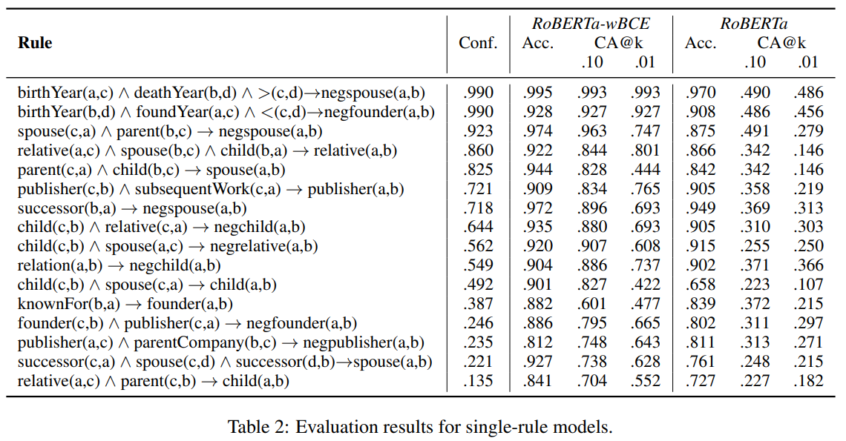
Experiements
Single soft rule
Fine-tune 16 models from 16 different positive and negative rules using 16k training samples per rule
models fine-tuned using RoBERTawBCE perform better on CA@k

Slide 24
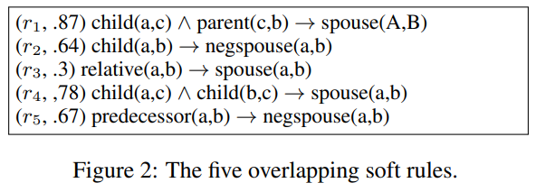
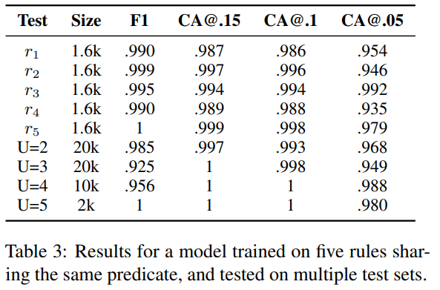
Experiements
Rules overlapping on conclusion
Dataset contains five soft rules(Fig2)
Train a model on the dataset and test it:
(1) on a test set for each of the five rules separately
(2) on test sets with n triggered rules
The model achieves high score both on the single sets and on the sets with interacting rules
The high scores indicate that PLMs can actually learn the interaction between multiple soft rule

Slide 25
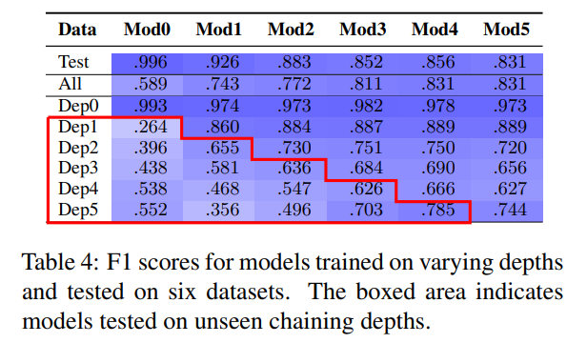

Experiements
Rule chaining
Dataset $D≤x$ contains hypothesis that need at most $x$ chained rules
Possibly due to the need for more training examples in order to learn such depths
lower scores in the constant-depth test sets as the models are being tested on unseen rule chains

Slide 26
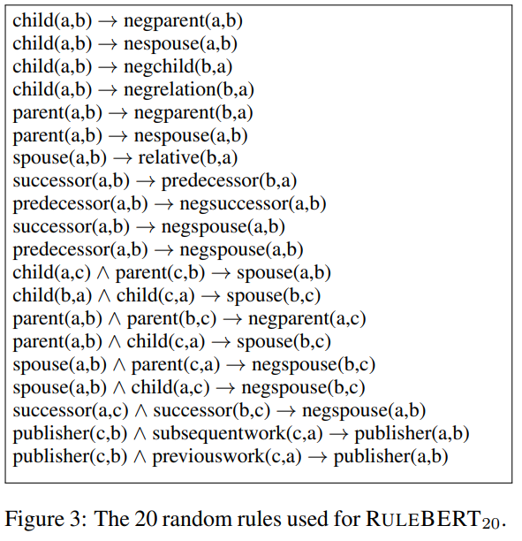
Experiements
Testing RULEBERT on unseen rules
Fine-tune it with only twenty randomly selected rules and call it RULEBERT20
Divided into two groups:
(1) Five rules containing predicates that were used in the rules
(2) share no predicates with the fine-tuning rules

Slide 27
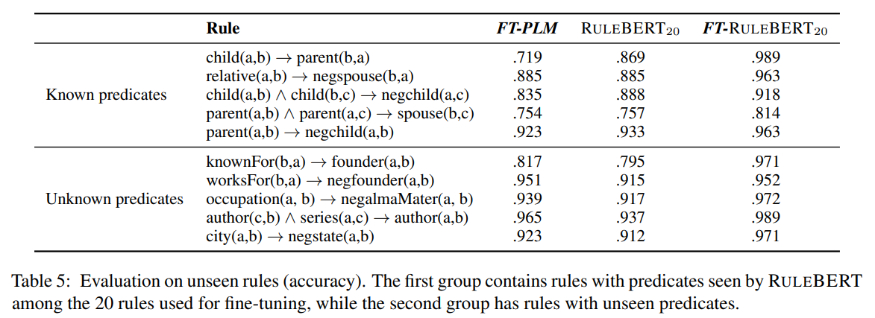
Experiements
Testing RULEBERT on unseen rules
RULEBERT20 outperforms the fine-tuned model (FT-PLM) on the first group
the accuracy of RULEBERT20 is high on the second group, but FT-PLM performs better

Slide 28
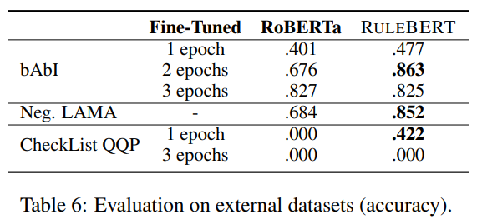
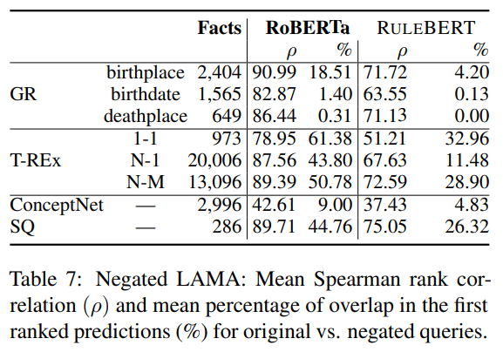
RULEBERT on External Datasets
Negated LAMA Experiments

Slide 29
Conclusion
Conclusion
Studied whether PLMs could reason with soft rules over natural language
explored the inference capabilities of Transformer based PLMs, focusing on positive and negative textual entailment
Future work
Non-entailment
Open the development of explainable models

Slide 30
Thanks for listening

